Slide 1
12.06.2024
AUF/5: Setup of a Framework for Employing Foundation Models in Autonomous Driving
Supervisor: Marion Neumeier
Team Members:
Yamin Mollah (Lead)
Md Shiful Islam
Md Fuad Hasan
Elvis Eric Soans
Manav Joshi

Slide 2
Overview
Foundation Models for Autonomous Driving
Autonomous Driving relies on accurate and adaptable navigation systems.
ViNT (Visual Navigation Transformer) is a goal-conditioned visual navigation model.
Designed to:
Enable accurate and efficient navigation in structured environments.
Use visual data (e.g., robot observations) to predict paths to specific goals.
Key Features:
Powered by transformer architectures for processing visual and spatial inputs.
Learns from diverse datasets, enabling generalization across robot types and environments.
Excels in tasks where goal alignment and visual context are critical.
Part of the General Navigation Model family, alongside GNM and NoMaD.

Slide 3
Project Goals
Foundation Models for Autonomous Driving
Develop universal navigation policies for Autonomous Driving.
Enable cross-robot adaptability using diverse datasets.
Balance between goal-directed navigation and exploration.
Leverage advanced architectures (e.g., transformers, diffusion policies).

Slide 4
Overview of Models
Foundation Models for Autonomous Driving
GNM: Foundational navigation model for diverse environments.
ViNT: Vision-based transformer model for goal-conditioned tasks.
NoMaD: Diffusion-based model for navigation and exploration.

Slide 5
GNM & NoMaD – Diffusion-Based Policies
Foundation Models for Autonomous Driving
General Navigation Models (GNM) aim to:
Generalize across multiple robots.
Adapt to new environments and tasks.
Operate with minimal additional training.
NoMaD – Diffusion-Based Policies:
Core Idea:
Generate trajectories via iterative refinement of noisy paths.
Key Features:
Handles uncertainty with diverse trajectory predictions.
Combines navigation and exploration using goal masking.
Strengths:
Adapts well to dynamic and unstructured environments.

Slide 6
ViNT – Vision Transformer
Foundation Models for Autonomous Driving
Core Idea:
Goal-conditioned navigation using transformer architectures.
Key Features:
Superior in structured environments.
Highly efficient for vision-based tasks.
Strengths:
Fast and accurate trajectory predictions.

Slide 7
Model Comparisons
Foundation Models for Autonomous Driving
Aspect | GNM | ViNT | NoMaD
Core Technology | General ML | Vision Transformer | Diffusion Policies
Focus | General use | Goal-conditioned tasks | Navigation & exploration
Strength | Broad use | Accurate goal alignment | Handles uncertainty
Ideal Scenarios | General tasks | Structured environments | Dynamic environments

Slide 8
Data Pipeline
Foundation Models for Autonomous Driving
├── <dataset_name>
│ ├── <name_of_traj1>
│ │ ├── 0.jpg
│ │ ├── 1.jpg
│ │ ├── ...
│ │ ├── T_1.jpg
│ │ └── traj_data.pkl
│ ├── <name_of_traj2>
│ │ ├── 0.jpg
│ │ ├── 1.jpg
│ │ ├── ...
│ │ ├── T_2.jpg
│ │ └── traj_data.pkl
│ ...
└── └── <name_of_trajN>
├── 0.jpg
├── 1.jpg
├── ...
├── T_N.jpg
└── traj_data.pkl
Data Sources:
Public datasets (e.g., RECON, GoStanford).
Custom robot trajectory data (collected via ROS).
Data Processing Steps:
Convert raw data into training-ready formats (images and trajectory data).
Split into training and testing subsets.
Dataset Structure:
Images of robot's observations.
Trajectory data (position, yaw).
Data Set Structure

Slide 9
Training Framework
Foundation Models for Autonomous Driving
Steps:
Define configuration parameters (e.g., datasets, learning rates).
Train models using training scripts (train.py).
Save checkpoints for further fine-tuning or evaluation.
Model-Specific Training:
GNM/ViNT: Transformer-based learning.
NoMaD: Diffusion-based trajectory refinement.

Slide 10
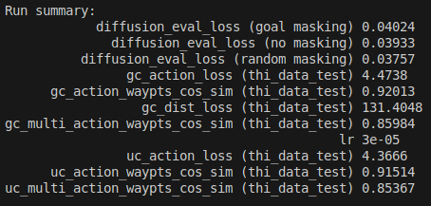
Run Summary
Foundation Models for Autonomous Driving
Metrics Observed:
diffusion_loss, action_loss, dist_loss, and cosine similarity.
Comparison of training vs. testing metrics.
Example Metrics:
Goal-conditioned losses (gc_action_loss, gc_dist_loss).
Evaluation of trajectory accuracy and goal alignment.
Figure: Evaluation Summary

Slide 11
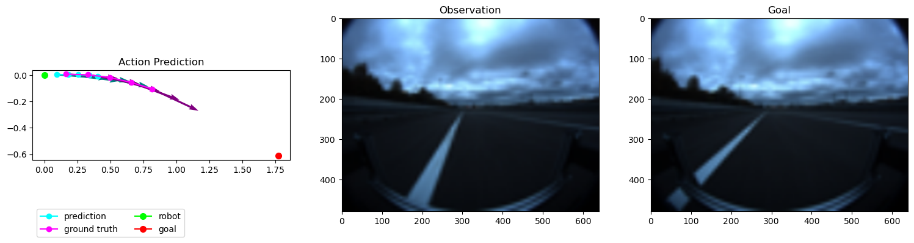
Visual Results – ViNT
Foundation Models for Autonomous Driving
Figure: THI Data Test Action-Prediction
Visualization:
Cyan (predicted path), pink (ground truth), green (current position), red (goal).
Observation and goal views.
Strengths:
Fast, accurate predictions in structured environments.

Slide 12
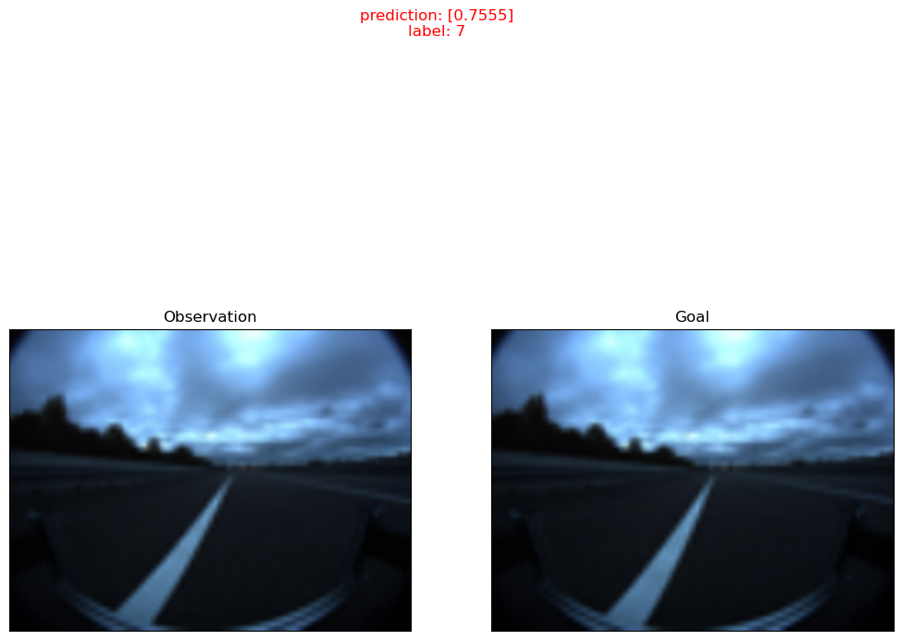
Visual Results – ViNT
Foundation Models for Autonomous Driving
Distance prediction are shown in the unit as given in the trajectory files.
Example: In our case in meters.
Figure: THI Data Test Action-Prediction

Slide 13
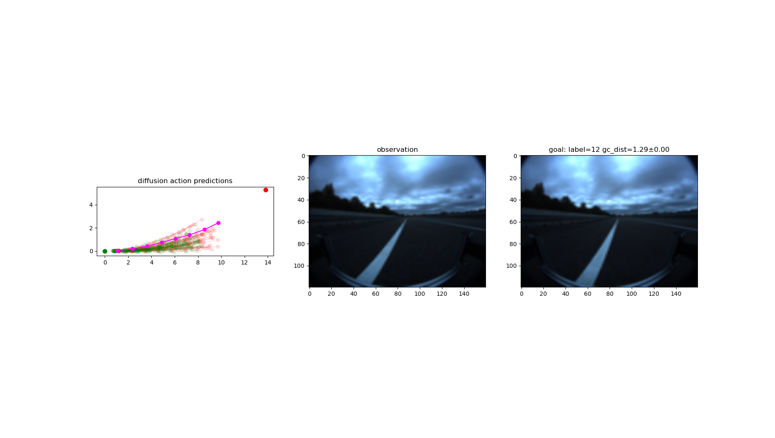
Visual Results – NoMaD
Foundation Models for Autonomous Driving
Current Position: Represented by the green dot as the starting point.
Goal Location: Shown as the red dot indicating the target.
Predicted Trajectory: The refined pink line aligns closely with the goal.
Trajectory Refinement: Faint pink paths represent explored candidates during diffusion.
Observation: Visual input aligns with the goal, ensuring task consistency.
Figure: THI Data test action sample

Slide 14
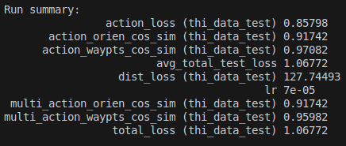
Comparison of Summary Outputs
Foundation Models for Autonomous Driving
Figure: THI Data Evaluation Summary using pre trained Check Points trained by Single Public Data, Named – GoStanford.
Figure: THI Data Evaluation Summary using pre trained ViNT Check Points

Slide 15
Applications
Foundation Models for Autonomous Driving
Real-World Use Cases:
Autonomous Driving: Enabling vehicles to navigate roads, avoid obstacles, and follow traffic rules.
Logistics: Assisting in autonomous delivery systems for last-mile solutions.
Warehousing: Efficient robot navigation for inventory management.
Search and Rescue: Exploring unknown terrains to locate survivors.
Home Automation: Navigating diverse home layouts for assistance tasks.
Healthcare: Autonomous navigation in hospitals for deliveries.

Slide 16
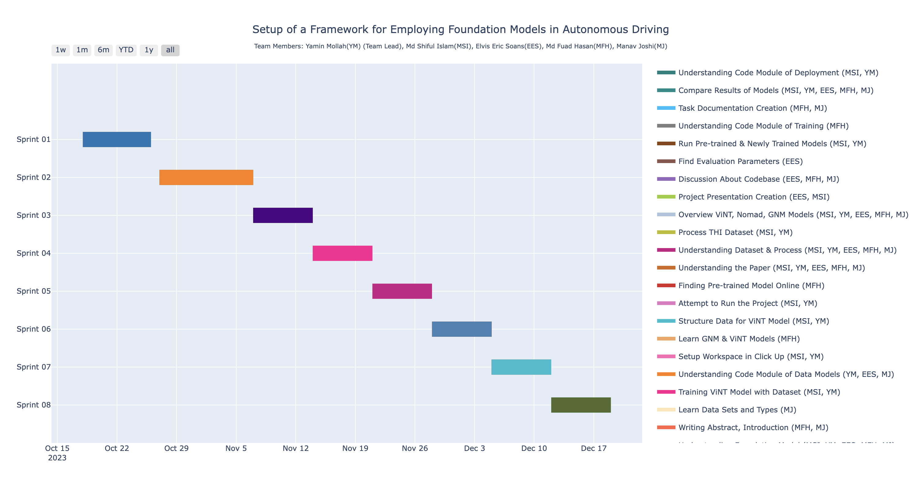
Gantt Chart
Foundation Models for Autonomous Driving
Figure: Gantt Chart
Link: https://yamin335.github.io/project_gantt_chart.html

